Slide 1
Match Maker
Mesh Parameterization, partioning and Texture Mapping
Qiao C. Chaucey L. Chong G
Apr 2016, Simon Fraser University
Notes:
frefer

Slide 2
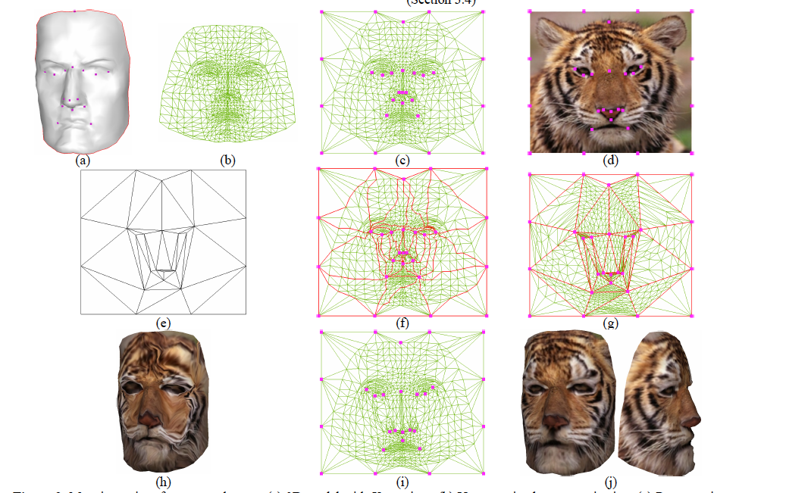
Acknowledgement
Director: Richard Zhang, Computing Science Department of Simon Fraser University
Matchmaker: Constructing Constrained Texture Maps
Vladislav Kraevoy Alla Sheffer Craig Gotsman
Computer Science Department, Technion-Israel Institute of Technology
Notes:
frfrfr

Slide 3
Outline
Project Overview and Work Flow
- Two methods of texture mapping
2.Some interesting algorithms
- Tutte Embedding
- Triangualtion
- Floodfill (original)
- Texture Mapping
3.Optimization
- Optimizations we did (original)
- Possible Futural Optimizations
4.A Demo

Slide 4
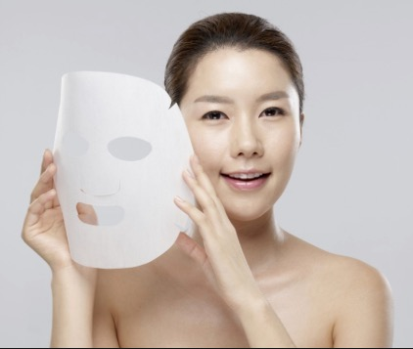
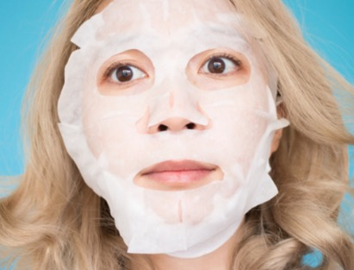
Project Overview and Work Flow ----------------------------------------------------------------------
Intuition?
Map 2D image on 3D face

Slide 5
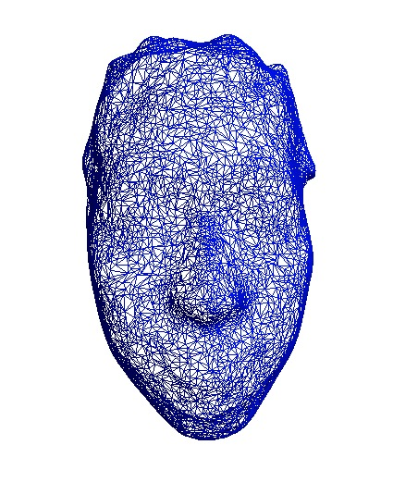
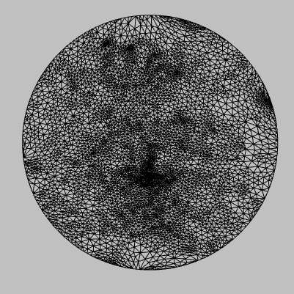
Pre-processing
1.Modeling
2. Extract face
→
3.Tutte Embedding.(flatten) We only reset every vertices’ coordinates

Slide 6
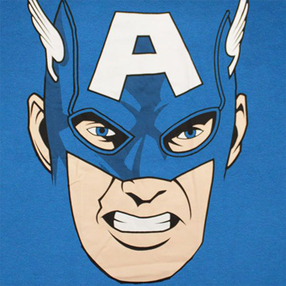
Next, Texture Mapping?
Method 1 – Direct Mapping
→
→
Index mapping
(because we preserved the
indices)
Coordinate mapping

Slide 7
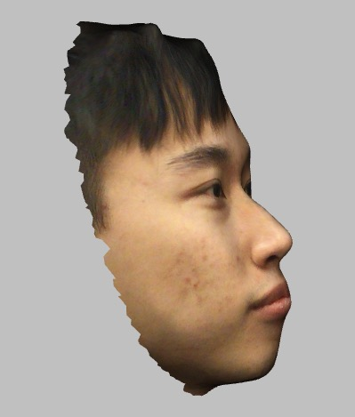
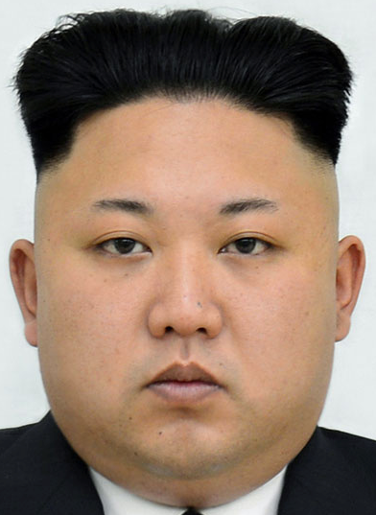
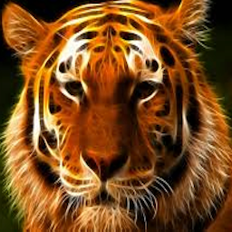
Result 1 – Direct Mapping

Slide 8
Result 1
This seems not bad because General Kim and our model have similar facial structures
However, tiger’s nose, mouth are not in place

Slide 9
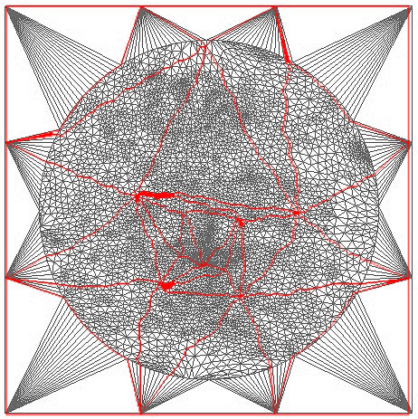
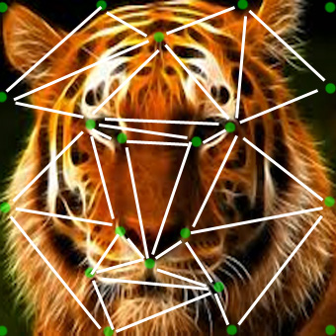
To avoid misplacing –
Match facial regions
Tiger
Face
Human
Face
mapping human’s forehead to tiger’s forehead
human’s face to tiger’s face
human’s nose to tiger’s nose

Slide 10
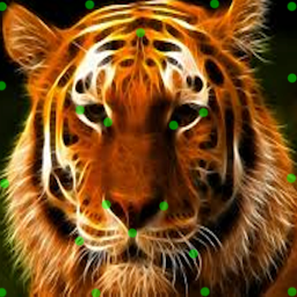
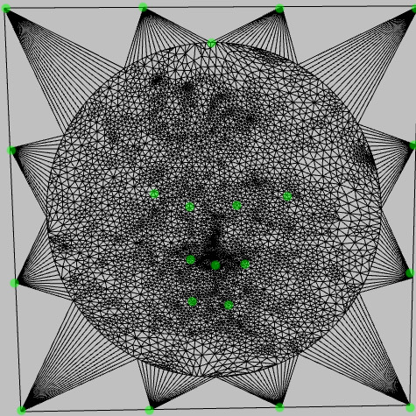
Match facial regions
Identify regions- Constraint points
Human
Face
Tiger
Face
1
2
4
3
1
2
3
4
1
2
3
4

Slide 11
2 Construct regions from constraint points
-Triangulation
Tiger
Face
Human
Face

Slide 12
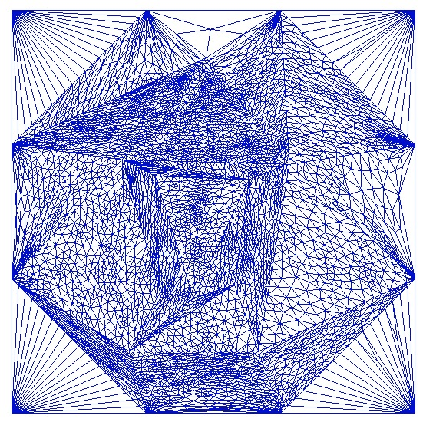
2 Adding constraints to mapping process
Tiger
Face
Human
Face
By Tutte embedding, we “stuff” human’s face vertices into tiger’s corresponding face regions

Slide 13
Next, texture mapping?
→
→
Index mapping
Coordinate mapping

Slide 14
Result 2 Constrained mapping
Result 1
Direct mapping
Pros: Eyes & nose are in place
Cons: Distorted (Tutte
Embedding’s fault)
Pros: Smooth
Cons: Eyes & nose not in place

Slide 15
2.Some interesting algorithms
- Tutte Embedding
- Triangualtion
- Floodfill (original)
- Texture Mapping

Slide 16

Tutte Embedding
→
(Richard Zhang)
Known Value:
1. Identity matrix I
2. Connectivity Cint and Cout (similar to adjacency matrix of a graph)
3. Manually-specified convex boundary points Xext
Unknown Value:
Xint

Slide 17
2.Some interesting algorithms
- Tutte Embedding
- Triangualtion
- Floodfill (original)
- Texture Mapping

Slide 18
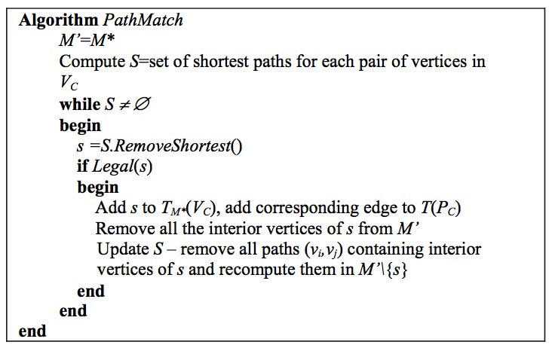
Triangulation

Slide 19
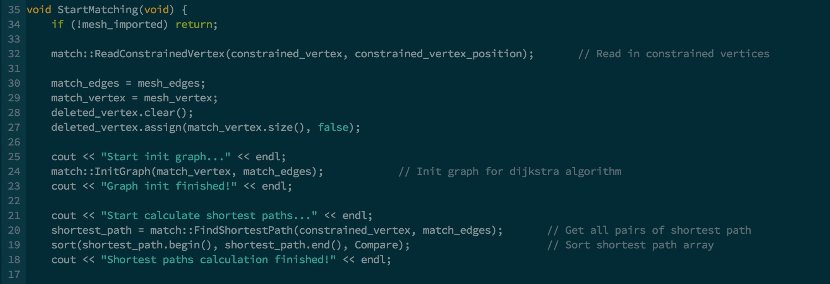
Triangulation

Slide 20
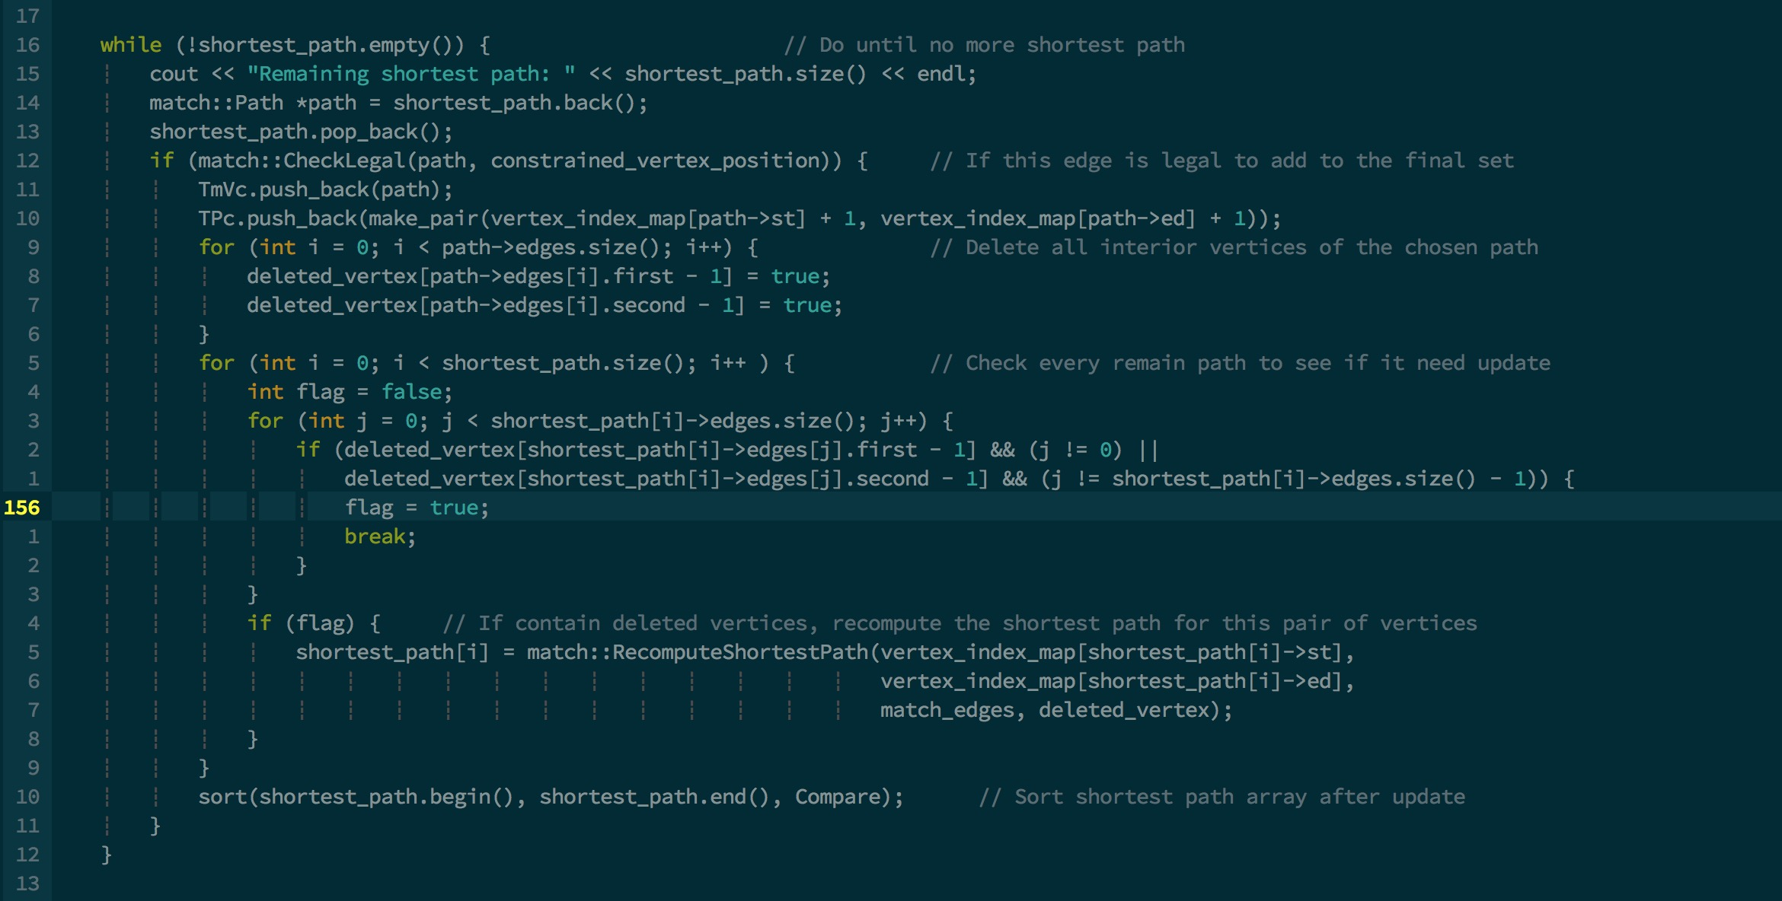
Triangulation

Slide 21

Triangulation

Slide 22
2.Some interesting algorithms
- Tutte Embedding
- Triangualtion
- Floodfill (original)
- Texture Mapping

Slide 23
Flooding (Original)
- The main problem
- How to find sub-regions?
- Sidedness test?
- Flooding by vertex?
- Flooding by face?
- Flooding by face with edge test!

Slide 24
2.Some interesting algorithms
- Tutte Embedding
- Triangualtion
- Floodfill (original)
- Texture Mapping

Slide 25
texture mapping
→
→
Index mapping
Coordinate mapping

Slide 26
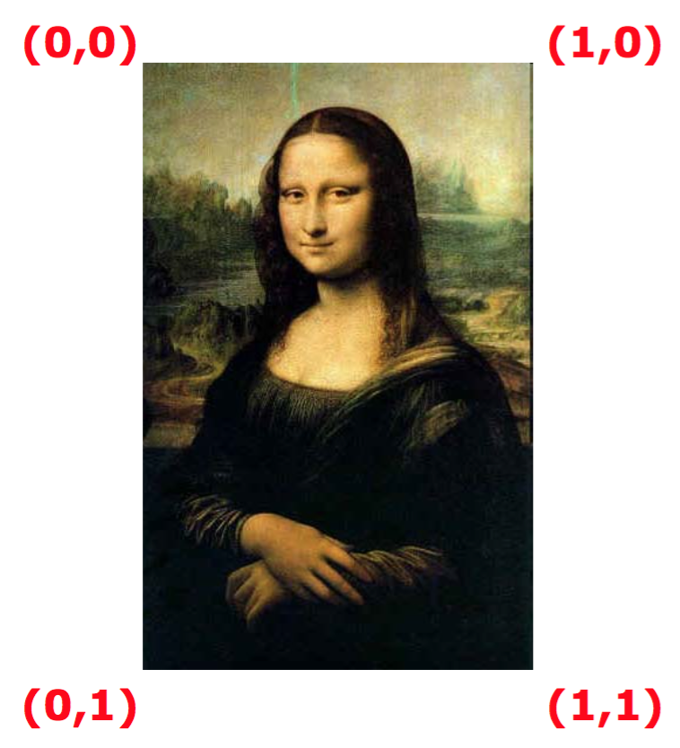
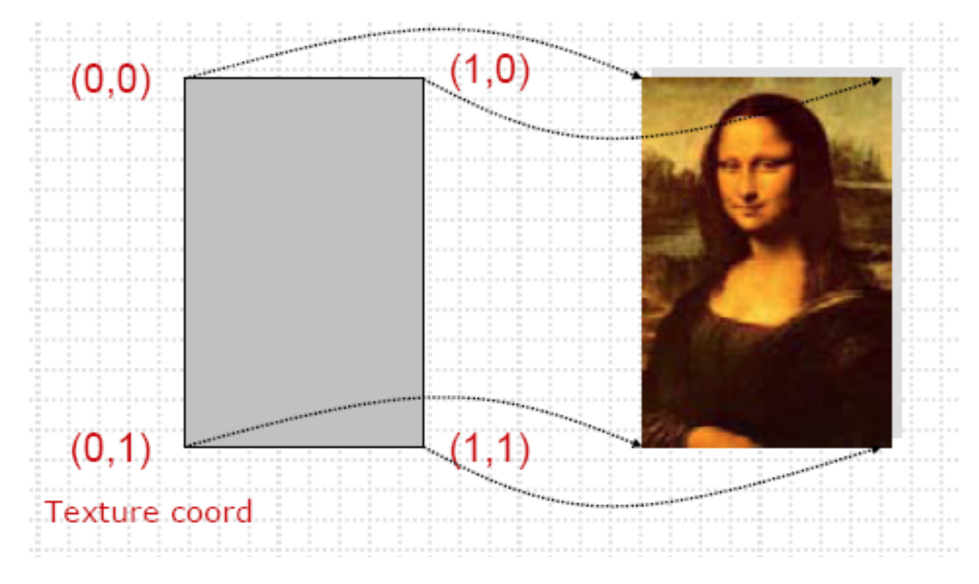
Principle of Texture mapping

Slide 27
3.Optimization
- Optimizations we did (original)
- Possible Futural Optimizations

Slide 28
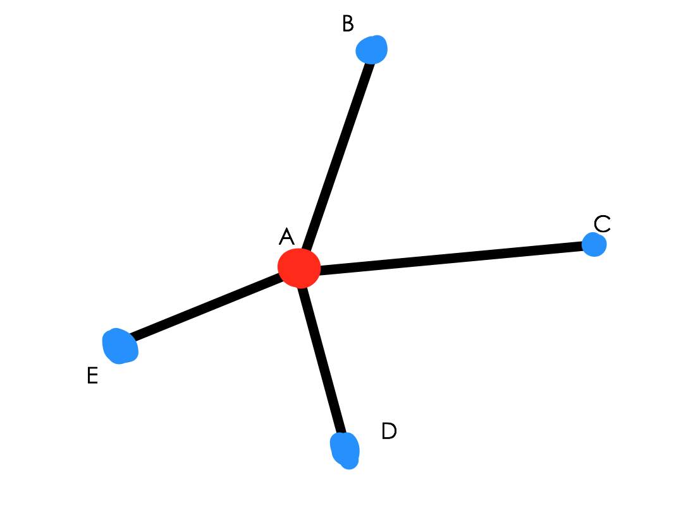
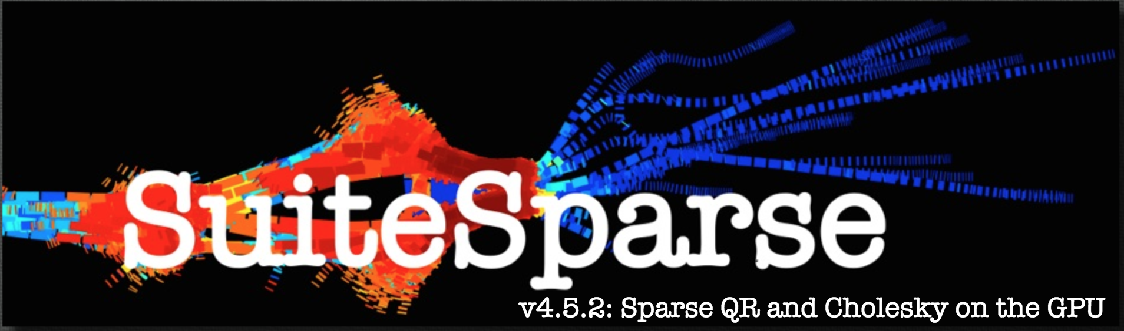
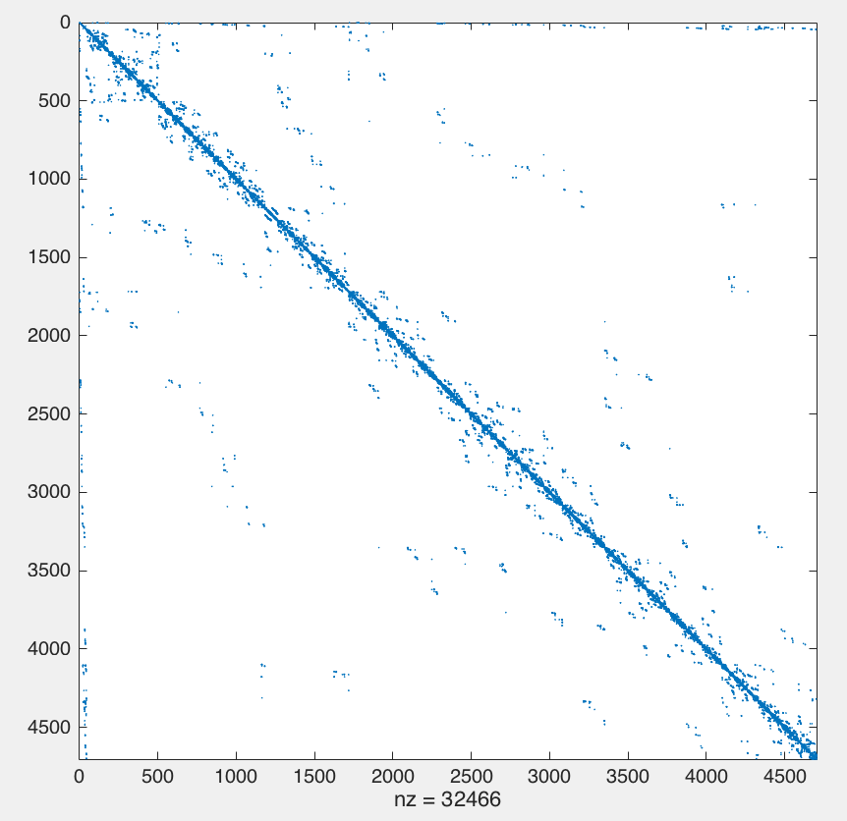
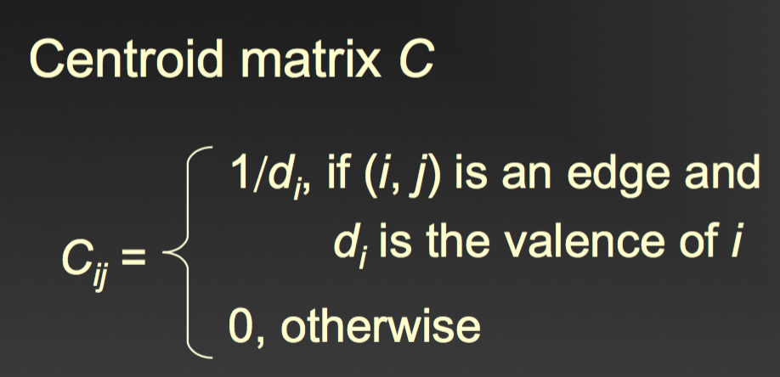
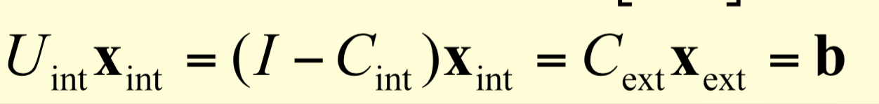
Matrix of Uint

Slide 29
3.Optimization
- Optimizations we did (original)
- Possible Futural Optimizations

Slide 30
Possible Futural Optimizations - Smoothing
Result of constrained mapping
What causes the distortion?
Tutte Embedding only keeps two characteristics
of the original mesh: 1. connectivity 2. boundary
The relative positions of the original vertices are
scrambled
How to get rid of the distortion?

Slide 31
Task Distribution
Qiao C.
- Convert 3D model to .smf format
- Extract face from 3D model
- Tutte embedding 1 (from 3D to 2D)
- Virtual bounding
- Provide constraint points
- Tutte embedding 2 (“stuff” vertices into tiger’s face)
- Idea of using floodfilling to construct face regions
Chauncey L.
- Direct Texture Mapping
- Optimization of tutte embedding
- Constrained texture mapping
- Testing
- Gif for ppt
- Report
Chong G.
- Mesh shortest path implementation
- Matching part implementation
- Face flooding implementation
- Part of PPT and report

Slide 32
DEMO

